Slide 1
Molecular Biology Biol 480
Lecture 27 April 5th , 2019

Slide 2
Announcements/Assignments
Exam 3—returned Today
Lab journals will be graded for a “final grade” of an additional 10 possible points for completeness and usefulness as a lab journal. (Please don’t just tape/fold in all the handouts).

Slide 3
Where were we? Mutations
Mutations---changes in DNA.
Various classifications of mutations
Various outcomes for protein function and changes in phenotype
Be sure to have an understanding of classifications of mutations based on the central dogma, and on protein function.

Slide 4
How do mutations arise?
Mistakes in DNA replication
Changes to nucleotides or nitrogenous bases, that affect base-pairing
Once a DNA molecule’s sequence is changed, all subsequent daughter molecules derived from the strand with the mutation will carry the same change.

Slide 5
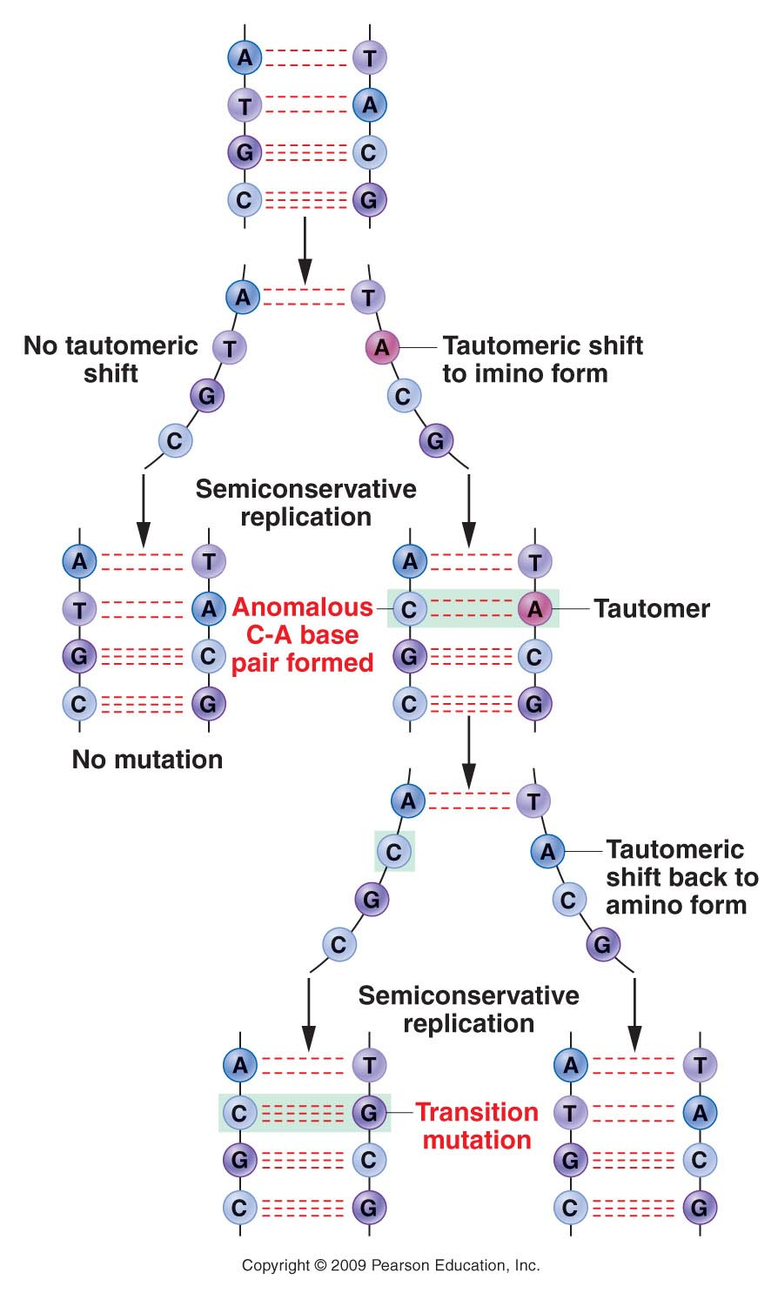
Figure 16.3
Notes:
Figure 16-3 Formation of an A=T to G=C transition mutation as a result of a tautomeric shift in adenine.

Slide 6
But how do mutations arise…
In both cases, mutations can be:
Induced---Caused by an external factor or condition of the cell. For example, UV light causes/induces pyrimidine dimers to form. Limiting sun exposure reduces this type of mutation associated with skin cancer!
Spontaneous—unavoidable, random changes not associated with any specific agent or condition.

Slide 7
Spontaneous mutations
DNA pol errors
Tautomeric shifts
Depurination
Deamination
Oxidative damage
Different types of reactive oxygen species (ROS) are generated during aerobic respiration.
Superoxides (O₂⁻)
Hydroxyl radicals (free radicals) .OH Oxygen has unpaired electron
H₂O₂

Slide 8
ROS can chemically alter/damage DNA in several different ways, including DNA breaks, base alterations, loss of bases…
DNA is constantly exposed to unavoidable oxidative damage, much like that caused by radiation exposure.

Slide 9
Foods claiming to be “antioxidants” have chemicals that naturally absorb or deactivate ROS.
They claim to provide protection from cancer causing mutations (DNA damage by ROS) and other diseases associated with oxidative damage.

Slide 10
Spontaneous mutations…continued
Transposable DNA elements/transposons
DNA sequences that naturally move between or within genomes.
All organisms have transposons-–sometimes comprising a large percentage of the genome
Depending on the insertion position, transposons can alter regulatory sequences or change coding sequences, create stop codons, cause double strand breaks
https://www.nature.com/scitable/topicpage/transposons-the-jumping-genes-518

Slide 11
Examples—Please read details
Insertion sequences (IS elements) and transposons (Tn elements) in bacteria
These elements encode their own enzyme “transposase” AND cis elements to allow removal and insertion at different chromosome sites.
What is the difference in IS and Tn elements? How do they work? Why are Tn elements of special interest to human health?

Slide 12
Transposons in maize/corn
20 years BEFORE transposons were identified in bacteria, Barbara McClintock discovered evidence of transposons in maize.
The Ac-Ds system allows movement of transposons. (Please read how one element controls the movement of the other)

Slide 13
Published in 1948…
Using a microscope, McClintock noted the movement of a chromosome element to a different location was associated with disruption of pigment in corn kernels.
Barbara McClintock’s hypothesis and description of “jumping genes” was openly criticized and doubted by many at the time of her pivotal work. But she was finally awarded the Nobel Prize in 1983.

Slide 16
Barbara McClintock

Slide 17
Transposable elements in Drosophila
Read about Copia and P elements
Transposons in Humans
~50% of the human genome is composed of mobile genetic elements! (table 15.5). Although most of these elements have lost their “jumping” activity, several human disease phenotypes are discussed in your text resulting from insertion of these elements. READ and understand

Slide 18
Recall?....
In Biol 215/genetics course, we did molecular genotyping of a gene/locus called PV92.
The locus shows variability in humans---2 alleles—one containing an transposable element called an Alu repeat.

Slide 19
Using/applying mutations in research
Experiments/assays have been developed to:
Test the mutagenicity of compounds
Read about the Ames test
Purposely introduce mutations to study specific phenotypes—Read about the forward genetics approach to identifying genes important in colorectal cancer. Read about this.
Noting the importance of transposons in evolution.
Some genes have evolved from transposons
Many genes/alleles show evidence of transposon sequences within them.

Slide 20
Moving forward!
Chapter 16---Regulation of gene expression in prokaryotes.
We’ve spent a lot of time preparing to look at specific mechanisms of gene regulation.
We start with prokaryotes---single celled organisms.
Most gene regulation is in response to environmental conditions.
Most gene regulation is at the level of transcription initiation. (but this is not the only level of regulation possible.)

Slide 21
The terminology
If gene expression is continuous (transcription occurring at basically the same rate all the time) we call this constitutive expression.
We need some RNAs and proteins at essentially the same level all the time---for example, glycolysis enzymes.
Genes that are expressed at relatively high levels all the time are referred to as “housekeeping genes”

Slide 22
Most genes are not housekeeping genes…
Genes can be “turned on”—transcription starts after a time of low or no transcription. Such genes are said to be inducible and the molecule(s) responsible are called inducers.
E. coli can be induced to make lactose metabolism enzymes if lactose is present. Lactose in fact, induces the new gene expression.

Slide 23
In prokaryotes, genes encoding enzymes needed for catabolism (breakdown of big molecules for energy production) are often inducible.
The substrate of the enzymes often induces their production. When lactose is available and needs to be broken down for energy, lactose, induces the transcription of lactose metabolizing enzymes.

Slide 24
In contrast…
Genes can be “turned off” or kept off if not needed. In this type of system a specific molecule inhibits transcription of the gene. This molecule is called a repressor.

Slide 25
Repressible systems are often used to regulate enzymes needed in anabolism (biosynthesis of large molecules from smaller precursors).
The repressor is often the end product of the biosynthetic pathway. If it is abundant, there is no reason to make enzymes to make more of it.

Slide 26
Both inducible and repressible systems can be used for positive or negative transcription regulation.
Be sure to study the difference.

Slide 27
In positive control---transcription occurs only if a regulator directly stimulates transcription.
In negative control—transcription occurs unless it is shut off by a regulator molecule.
**Lactose metabolism enzymes are regulated with both negative an positive control systems.

Slide 28
Let’s examine the Lactose (lac) operon
Recall prokaryotes have some of their genes in clusters, called operons. Operons encode polycistronic mRNA which encodes more than one protein. Operons encode several proteins which are needed for a common purpose.
The lac operon encodes 3 enzymes needed for bacteria to utilize lactose for energy.
See figure 16-1—but know the missing detail

Slide 30
lac Z, lacY, and lacA encode the 3 structural genes needed for lactose metabolism.
Read about the function of each protein in lactose metabolism.
Upstream of the structural genes are regulatory sequences, called the promoter, the operator, and the activator/CAP binding site.

Slide 32
Upstream of the regulatory region is a gene that encodes a repressor of the whole system.
The gene is labeled “I”. I encodes a protein, but the repressor protein is not needed to metabolize lactose. It is not one of the operon’s structural genes. It’s role is in regulation.

Slide 34
Let’s summarize the main details of the operation of the lac operon…then return to how we came to know these details.
First…bacteria normally utilize glucose (not lactose) using a set of enzymes other than lacZ, lacY, and lacA.
So most of the time it would be wasteful to make the lac proteins. They are usually repressed by the I protein.

Slide 35
I binds to a site within the regulatory region called the operator (O). O is close to the start site of transcription of the structural genes and physically blocks the ability of RNA polymerase to bind and begin transcription.
…Review…which parts of this system are cis-elements? Which parts are trans elements?

Slide 37
When lactose is present (and glucose is not) bacteria need to make lac Z, Y, and A.
Lactose de-represses/induces the system by binding to lac I, ,making Lac I unable to bind to O.
This allows RNApol to bind to the promoter and to slide to the +1 site to begin transcription.

Slide 39
You’ve likely noticed that there are other players in the regulation of lactose. A protein that is involved in regulation of several operons, called Catabolite Activating Protein (CAP) exerts positive control on the lac operon.
RNAP is actually fairly inefficient in binding the promoter---CAP greatly increases its efficiency.

Slide 40
CAP’s shape and function is dependent on another molecule, a nucleotide called cyclic AMP (cAMP). …recall how some nucleotides function outside of nucleic acids?...
cAMP levels are regulated by glucose!
High glucose levels----low cAMP
Low glucose levels---high cAMP

Slide 41
Let’s look at the whole picture----the elegant system used by bacteria to make sure they can use available nutrients (to make energy) without wasting energy!
There is only one situation in which the lac operon should be transcribed.

Slide 46
Step through this tutorial…
Not an animation, but an excellent dialog and illustration by Jacques Monod and Francois Jacob.
The first scientists to really explain how genes can be turned on and off.
http://www.dnalc.org/view/16688-Animation-33-Genes-can-be-turned-on-and-off-.html

